Slide 1
Medicine Shop Automation
CodeCannibals
Abhishek Kumar Sah (19CS10004)
Saumyak Raj (19CS30040)
Hritaban Ghosh (19CS30053)
Notes:
Saumyak

Slide 2
Agenda
Introduction
Software Features
Why We Chose MSA?
Why Django
Software Demo
Challenges we faced
Improvements Which Can be Done
Notes:
Hritaban

Slide 3

Introduction
Medicine shop automation is a convenient and easy-to-use application built to help medicine shop owners automate the management of their shop, and their transactions. It helps reduce a lot of manual labour, which involves managing such things and improving his productivity.

Slide 4
Software Features

Slide 5
Software Features
Store Vendor Information
Store Medicine Information
Store Vendor wise Supply Information
Sell Medicines to customer and print receipt
Update Threshold of Medicine acc. to JIT philosophy
Make search queries for medicines
Maintain Inventory of Usable and Expired Medicines
Maintains monetary transactions and generate revenue report

Slide 6
Why We Chose MSA?

Slide 7


Why this Project?
Medicine shop owners face tremendous labour in order to maintain their inventory and accounts
Replaces the traditional ways of maintaining records
Saves a lot of time and effort
For solving this we chose this project and decided to build a web application

Slide 8
Why Django?

Slide 9
Why Django?
Web Development Framework
Backend Integration
Database Integration
Complex front end designs can be easily implemented
Very interactive interface because of JavaScript
Supports template creation using HTML and CSS
Supports MVC Paradigm
Very Extensible so new features can be added easily later on
Form verification and error handling
Provides a built in SQLite database
Compatible with most major databases
Abstracts away complex SQL queries
Notes:
MVT Framework works in a very simple way as the Django server receives the request, the URL router checks the request to the suitable view, the view then grasps the data via models, after that it fills the template and sends it back to the user.
MVC- Model View Controller
The Model component corresponds to all the data-related logic that the user works with.
The View component is used for all the UI logic of the application.
Controllers act as an interface between Model and View components to process all the business logic and incoming requests, manipulate data using the Model component and interact with the Views to render the final output.
Because of form verification it will never go to unstable state because no invalid data will seep into the system.
Point 1 and 3 of database

Slide 10
Why Django?
Admin Support
Advantages of Python
Secure Authentication
Provides a built-in admin page
Admin page supports built in authentication and user creation
Very useful tool to debug
Simple fast and easy to use
It covers most of the use cases
Platform Independence
Vast library support.
Easy to read write and interpret
Easy to implement object oriented design
Provides built-in support for a secure authentication system.
Supports both authentication and authorization.
Notes:
Point 1 2
Point 1 2
Provides
Authentication confirms that users are who they say they are. Authorization gives those users permission to access a resource.

Slide 11
Software Demo

Slide 12
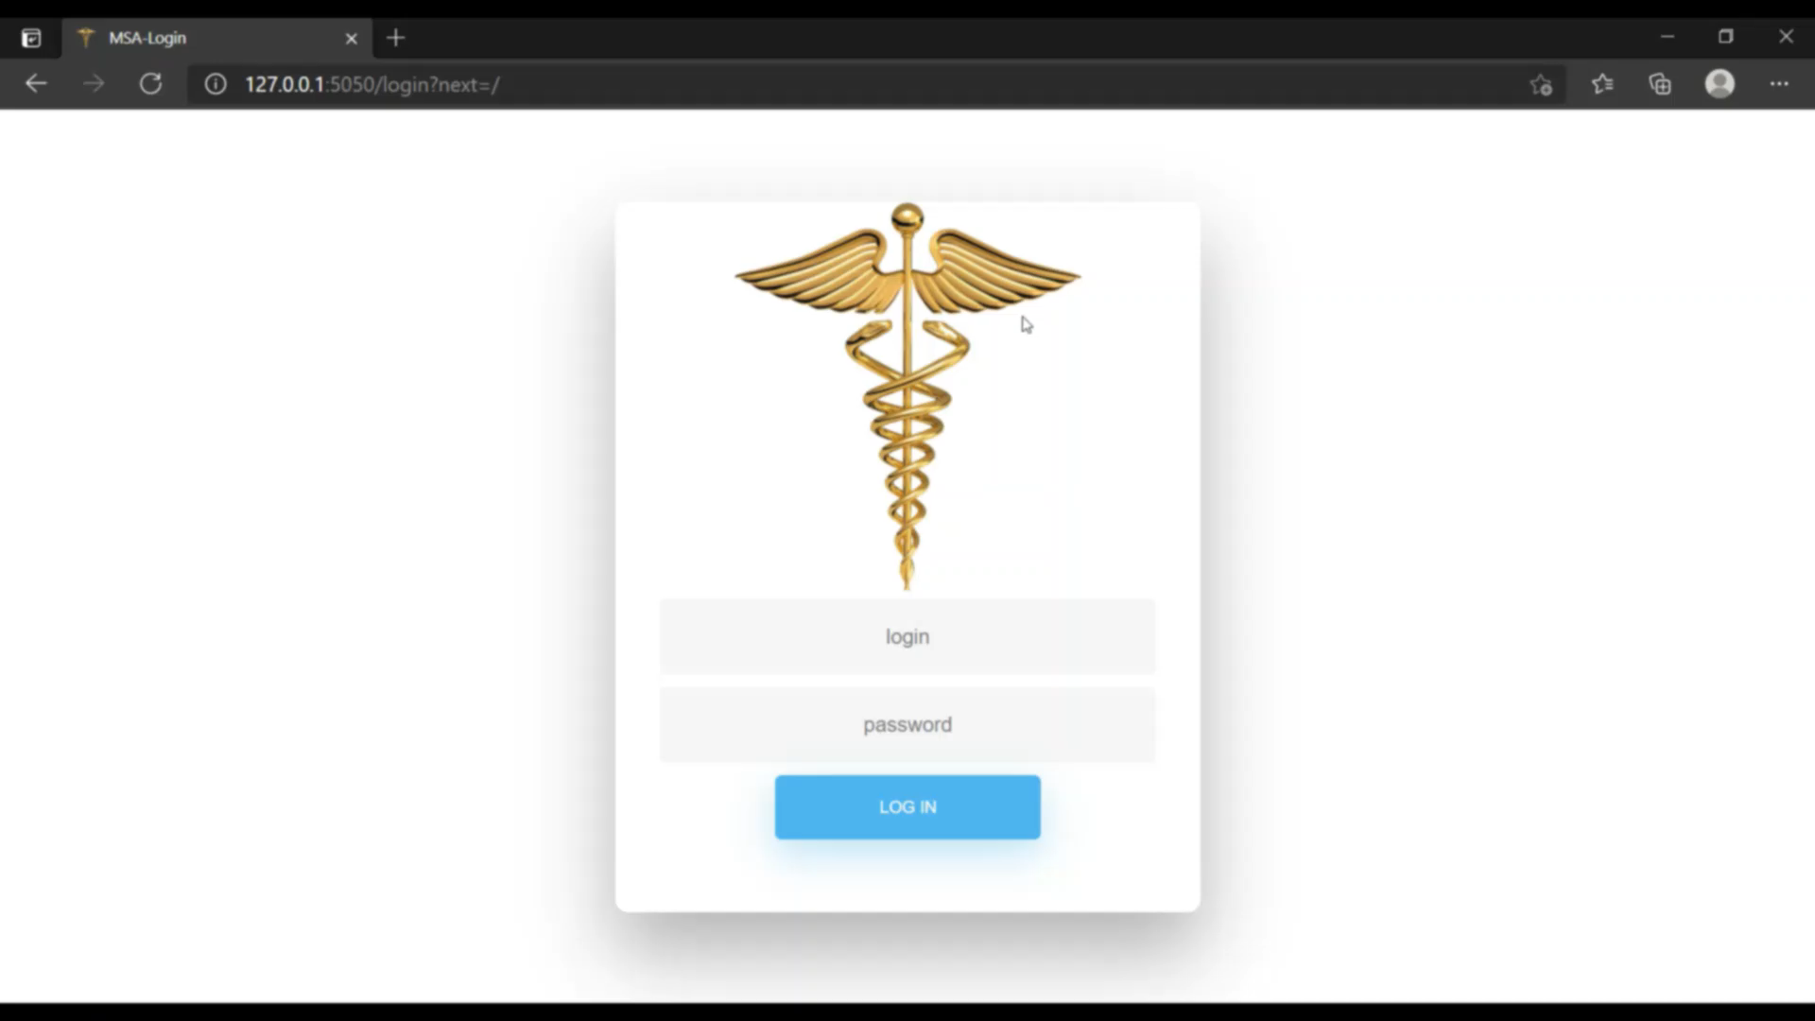

Slide 13


Challenges We Faced
Acquiring knowledge of databases, SQL, and all new cool stuffs we used for this project
Challenging Use Cases
Sell Medicine
New Supply
Changing Password
Working via online platform

Slide 14

What we Learnt?
Learnt to understand a real life problem from customer’s perspective
Learnt to build a web application
Acquired skill in web framework Django
Gained understanding of SQL and Databases
Learnt web designing with HTML CSS, JS and Bootstrap

Slide 15
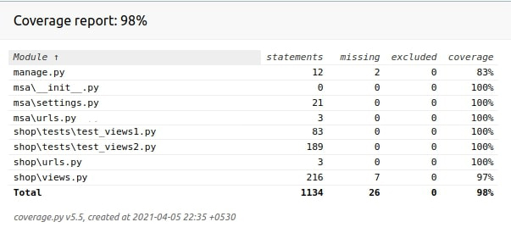
Coverage Report
Notes:
We have achieved 98%

Slide 16
Improvements Which can be done

Slide 17
Improvements which can be done
Extend the software for multiple accounts for shop with several branches
Add an employee database for shops with many employees and also manage their salaries
Reset password via email verification in case employee forgets his password
Receive order online from website of the shop
We can make a PWA which will run as a native application instead on running in a browser
Notes:
Progressive Web App

Slide 18

Software and cathedrals are much the same – first we build them, then we pray.

Slide 19
Thank you
CodeCannibalsls
Abhishek Kumar Sah (19CS10004)
Saumyak Raj (19CS30040)
Hritaban Ghosh (19CS30053)

